Slide 1
Genome editing, Justice
and Autonomy
Maurizio Balistreri
(Department of Philosophy and Educational Science; University of Turin)

Slide 2
Genome Editing, Social Justice and Equity
Genome editing as a ‘class’ project?
Genome editing as an enhancement rat race?
Genome editing as a gender project?

Slide 3
Justice and Genome Editing Technologies
Genetic correction and enhancement procedures could have a high or even prohibitive cost: maybe only the best-off people will be able to afford them.

Slide 4
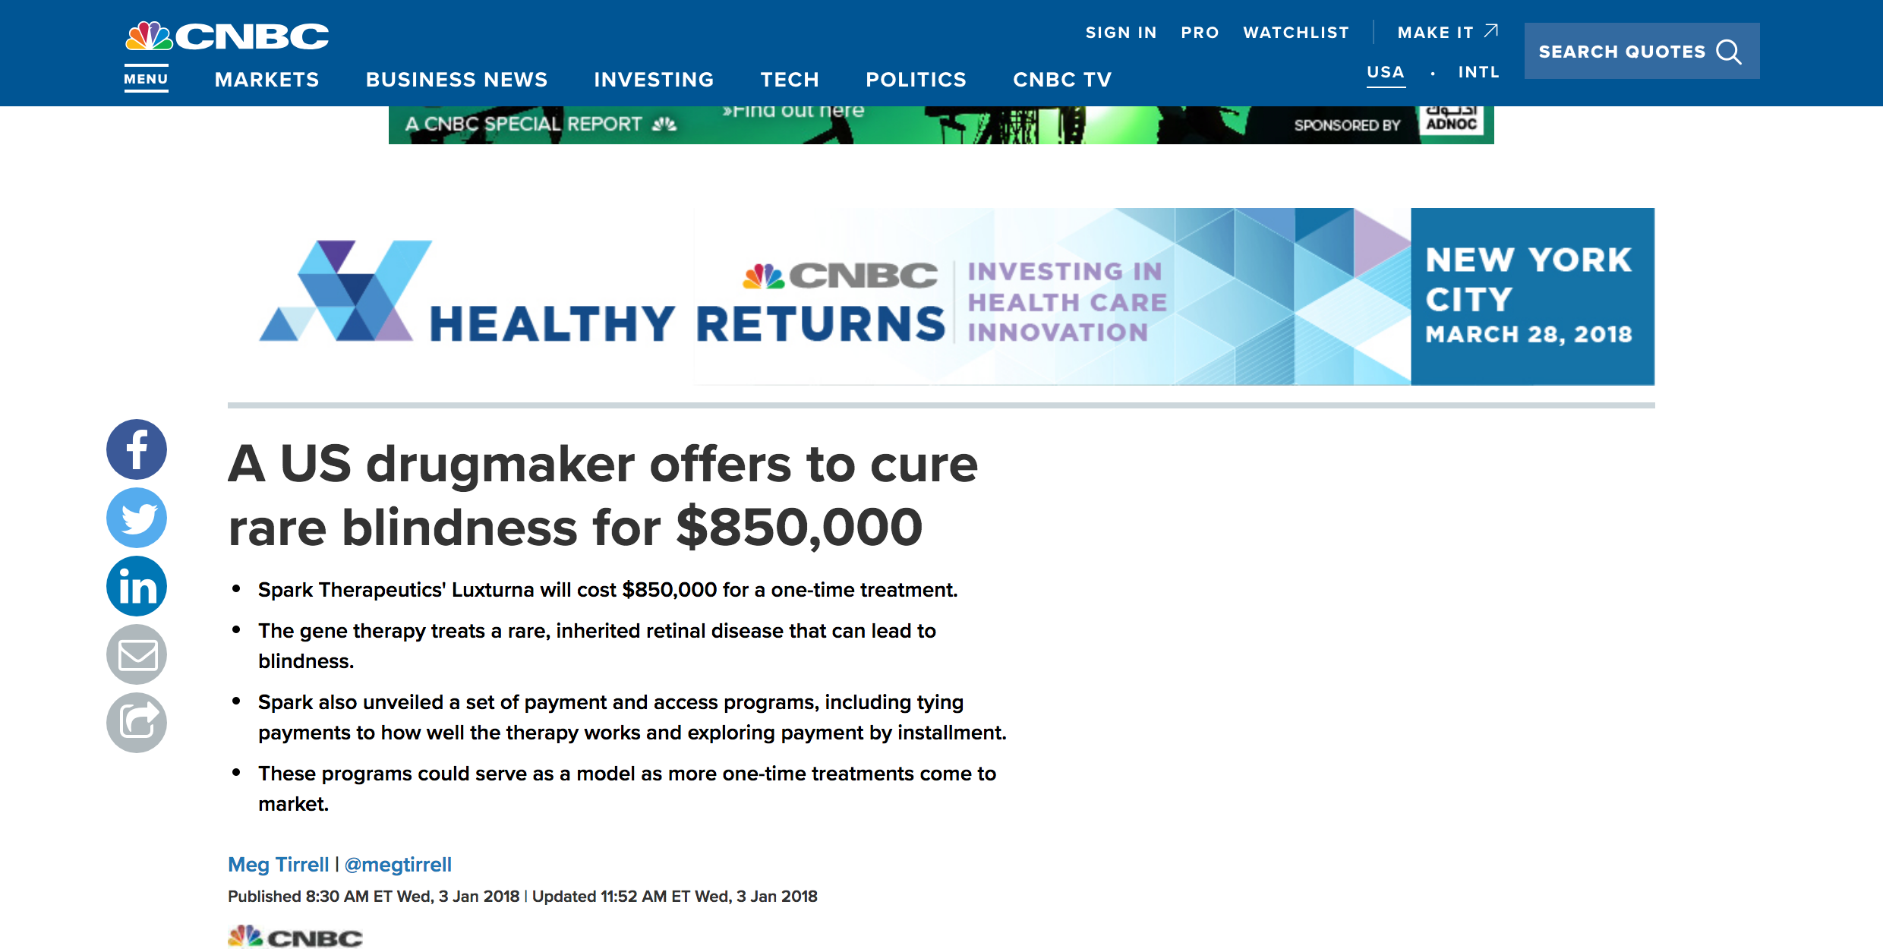

Slide 5
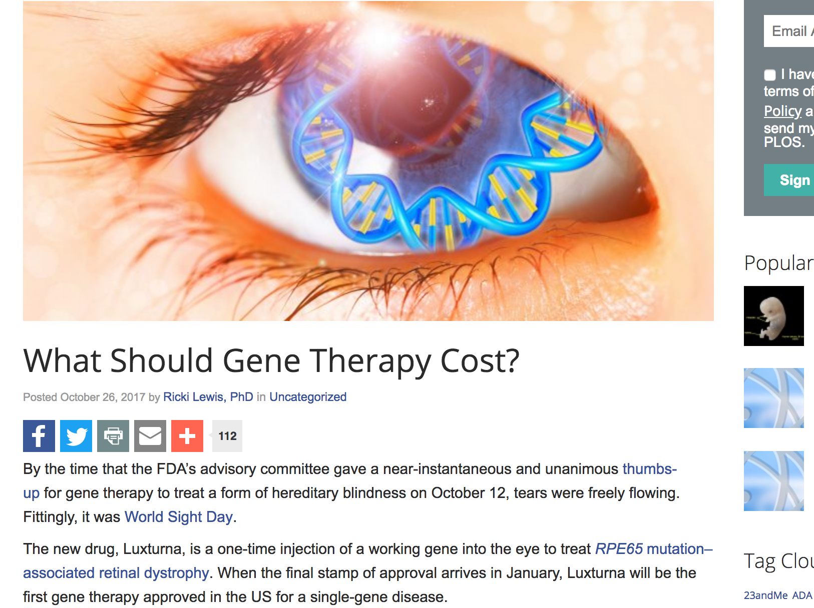

Slide 6
Justice and Genome Editing Technologies
Moreover, we could even imagine ‘universal’ access to genome editing. The point is that the last generation could always have more advantages than the previous ones, because it could have access to better and original interventions.

Slide 7
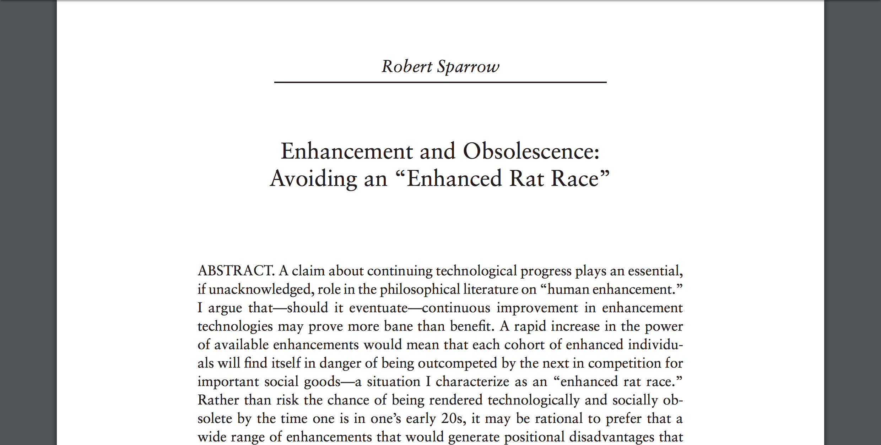

Slide 8
Risks for reproductive freedom
Then, we must also be aware that introducing new reproductive technologies may negatively affect our ‘reproductive freedom’. There is the risk that genome editing in the embryo (in both therapeutic and enhancing versions) becomes mandatory for people who wish to have a baby.

Slide 9


Slide 10
Intrusion by Ken Macleod
Hope won't take "the fix", a pill that cures genetic disease, and corrects all the errors in a foetus's genome. She's refused once, but pressure to comply is mounting and she won't get away with it again. She could easily claim faith group exemption, but she won't. She won't give reasons; she insists it's simply her decision.

Slide 11
About reproductive freedom
New eugenics start from the idea that the parents’ freedom of choice constitutes the best antidote against the danger of coercive state policies.

Slide 12
Reproduction at the age of genome editing
However, with the arrival of genome editing, correcting the unborn child’s DNA may seem the most reasonable and moral thing for a ‘future’ parent to do. Indeed, correcting the genetic code could be relatively simple: and the result would of course be that the embryo would come into the world without genetic anomalies.

Slide 13
Reproduction at the age of genome editing
If we assume that upbringing and genetic changes are analogous processes, why should a ‘liberal’ state consider upbringing obligatory but leave the gene therapies or enhancement completely to their parents?

Slide 14
Reproduction at the age of genome editing
Nevertheless, if germline genome editing became (legally) binding, women might be ‘forced’ to reproduce with ART and take responsibility and care about the genome of ‘future generations’.

Slide 15
Reproduction at the age of genome editing
Indeed, if the embryo were produced in vitro, diagnostic and later therapeutic intervention could be practised at once, at the moment of conception or immediately after. But if the embryo were produced sexually, genetic editing could only be performed in an advanced phase of embryo development, because many days could go by before the pregnancy is discovered by the woman.

Slide 16
Reproduction at the age of genome editing
If fertilisation occurred with assisted reproduction, genome editing may be practised on the zygote or on blastomeres. In contrast, if reproduction goes through sex, the germline genome editing would have to be practised on an multicell embryo: the risk of error would, then, be greater, as would the probability that some cells of the embryo do not receive the desired modification.

Slide 17
Genome editing as Gender Project?
Given that if genome editing becomes feasible, it will be a “gender project”, there is the risk that women who do not agree to let their embryo undergo genome editing intervention are considered morally irresponsible.

Slide 18
Genome editing as Gender Project?
It is not necessary for genome editing to become legally binding; women could be penalized and discriminated against simply on a moral level.

Slide 19
Genome editing as Gender Project?
Today, women who choose to have a child are often criticised if at the moment of conception, pregnancy and birth they also think of their own interests. Many people expect the pregnant woman to undergo invasive interventions to allow the condition of the embryo’s health to be monitored regularly.

Slide 20
Genome editing as Gender Project?
Further, it is often maintained that birth should always occur in hospital and women who choose labour and birth at home or in a maternity home put their own interests before the unborn child’s: so they are bad mothers.

Slide 21
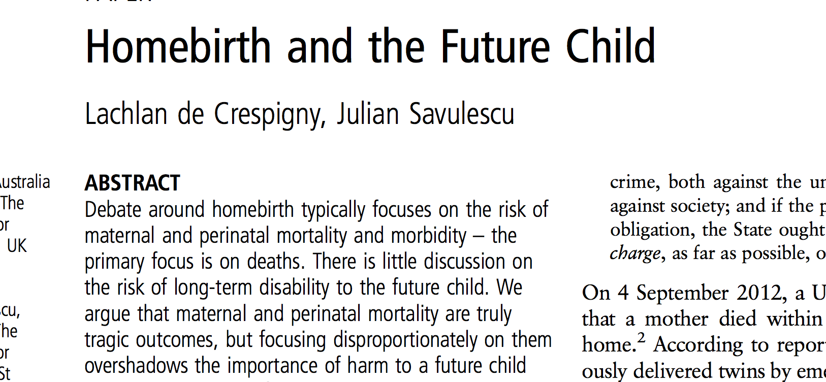

Slide 22
Genome editing as Gender Project?
Widespread, vocal disapproval of public breastfeeding is well documented, but women also face pressure when they decide not to breastfeed: “For many – as Fiona Wolland and Lindsey Porter argue – the messagge they receive is clear: mothers who do not breastfeed ought to have a darned good reason not to; bottlefeeding by choice is a failure of maternal duty” (p. 515).

Slide 23
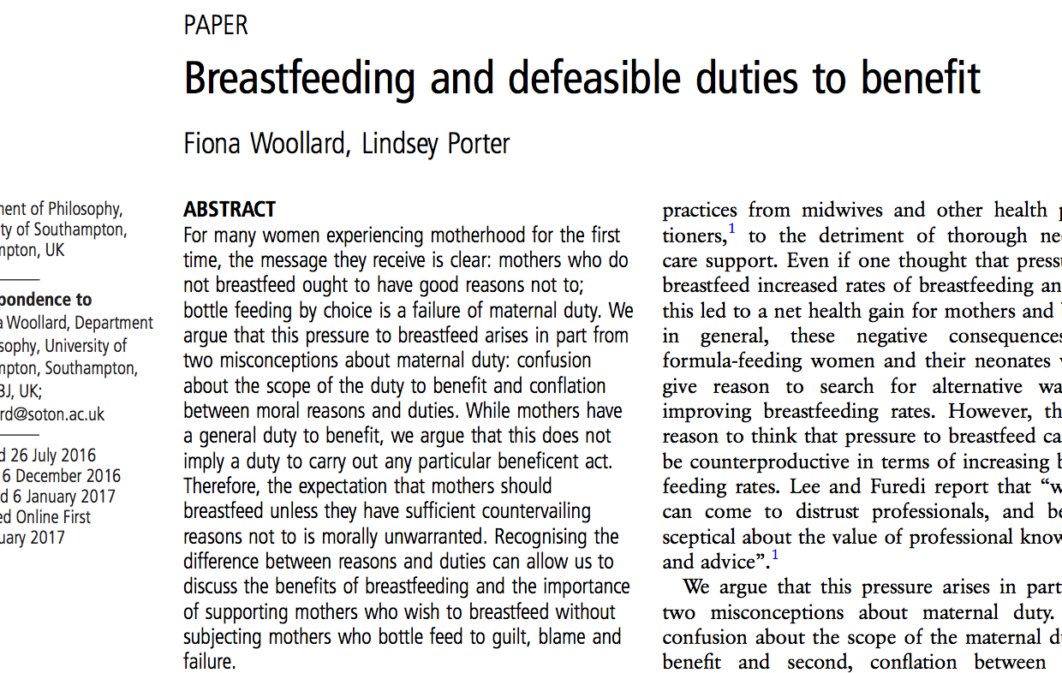

Slide 24
Genome editing as Gender Project?
Also in this case the pressure arises in part from a misconception about maternal duty: “the assumption arises from the fairly uncontroversial belief that mothers have a general beneficient duty towards their offspring and that if a given act benefits their children, they always have a duty to perform it” (p. 516).

Slide 25
Genome editing as Gender Project?
Why should we think that this attitude to women will change at the very moment when we use such technologies as germline genome editing? We cannot write off this problem as something not so important: in fact, secular and religious bioethics largely converge on women’s moral responsibility.

Slide 26
Genome editing as Gender Project?
Mothers clearly have a general duty to benefit their offspring: but this does not imply a duty to carry out each particular beneficial act. “Mothers do not have a moral duty to carry out each and every act that would benefit their baby” (p. 515).

Slide 27
Genome editing as Gender Project?
An assessment that does not take into consideration the interests of everyone concerned is only partial, and not entirely rational. The future child’s best interests are important, but the mother’s are just as important and worthy of attention.

Slide 28
Genome editing as Gender Project?
I agree that genome editing could be used to solve issues related to health care, resulting, by and large, in a substantial improvement of public life. But women should not be required to justify their reproduction decision and be subject to blame if they do not have a baby by assisted reproduction.

Slide 29
Genome editing as Gender Project?
Reproductive risks have always been a part of woman’s life: assisted reproduction would add new and important risks to motherhood.

Slide 30
Genome editing as Gender Project?
As Frida Simonstein explains, “IVF requires the use of drugs to stimulate the production of multiple ova, following which the ova are removed from the woman’s body, fertilized and inserted into her uterus”. (p. 5). “Would it be fair – Simonstein wonders – to add the pain and the risks involved in IVF to women’s challenging reproductive tasks?”

Slide 31
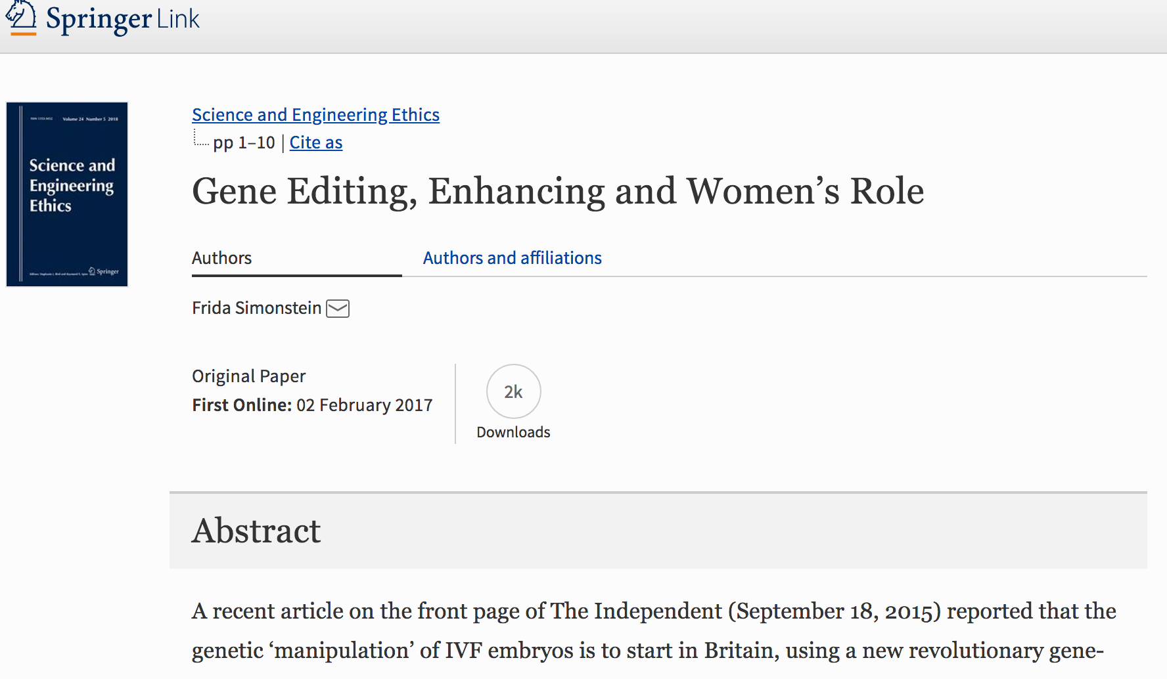

Slide 32
The future of genome editing
Imagine that you can take a pill that cures genetic disease, and corrects all the errors in a foetus's genome. Or imagine that you can have in vitro gametes and use an artificial womb: in this case what are the woman’s moral responsibilities?

Slide 33
Conclusion
The conclusion is that we must think about the responsibilities we have towards future generations and how fair it is to balance their interests with our own. Demanding that once pregnancy has been chosen, the woman sacrifice all her interests and well-being for the unborn child’s well-being is unfair.

